Slide 1
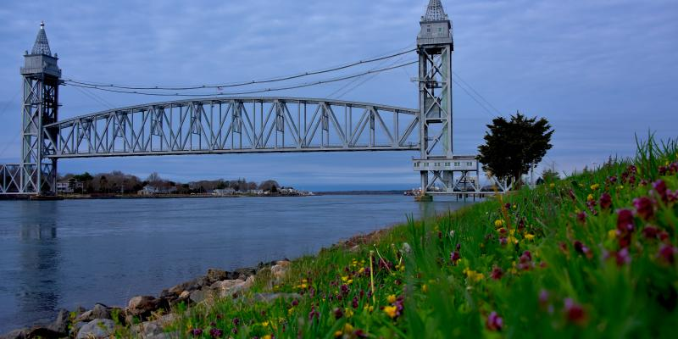

Town of Bourne
Financial Review
For the Year Ended June 30, 2022.
Presented by Erica Flemming, Finance Director
December 6, 2022

Slide 2
Presentation Agenda
General Fund Financial Results
Financial Policy Compliance
Other Funds (special revenue, trust funds, agency)
Enterprise Funds

Slide 4
General Fund
Revenue

Slide 5
Revenues
(All monies received from any source)
Major Revenue Sources:
  Property Taxes (76%) - calculated annually on the Tax Rate Recapitulation; limited to 2.5% of the previous year’s levy limit plus new growth, debt exclusion and other adjustments (Cape Cod Commission Tax)
  State Aid (11%) – Cherry Sheet Receipts (Chapter 70 Aid, Veteran's Benefits, Unrestricted General Gov’t Aid, etc.)
  Local Receipts (12%) – various tax and departmental revenues (motor vehicle, hotel, boat and meal taxes, recreational, licenses, permits, fees, fines, energy credits and other charges for services)
  Other (1%) – Host Fee (DOR has re-categorized this as a local receipt on the Tax Rate Recap)

Slide 6
Revenues by Source (Actual)
FY2022

Slide 7
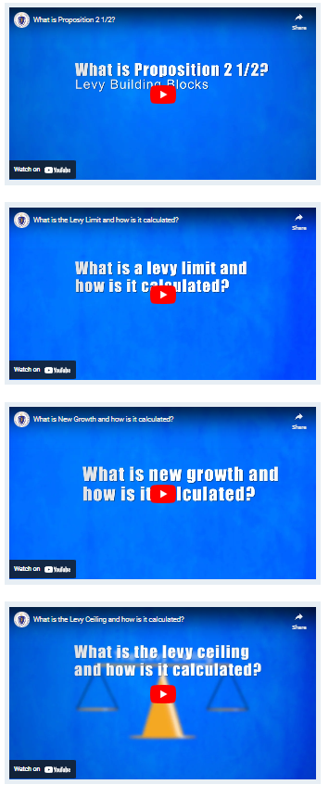
Property Taxes
Determining the Levy Limit
Prior year Levy Limit
Add 2.5 %
Add New Growth
Add Debt Exclusion
Add Cape Cod Commission Tax
= Max Allowable Levy
https://www.mass.gov/service-details/proposition-2-12-and-tax-rate-process

Slide 8
History of New Growth
Budget vs. Actual
Fiscal Year | Budgeted New Growth | Actual New Growth | $ Over (Under) Budget
2023 | $ 385,000 | $ 922,570 | $ 537,570
2022 | $ 370,000 | $ 659,406 | $ 289,406
2021 | $ 450,000 | $ 496,943 | $ 46,943
2020 | $ 550,000 | $ 522,773 | $ (27,227)
2019 | $ 600,000 | $ 601,987 | $ 1,987
2018 | $ 500,000 | $ 571,102 | $ 71,102
2017 | $ 400,000 | $ 655,699 | $ 255,699
2016 | $ 300,000 | $ 651,484 | $ 351,484
2015 | $ 100,000 | $ 576,154 | $ 476,154
2014 | $ 200,000 | $ 222,805 | $ 22,805
2013 | $ 150,000 | $ 361,352 | $ 211,352
2012 | $ 100,000 | $ 299,625 | $ 199,625

Slide 9
Notes:
)

Slide 10
Debt Exclusion
(Added to Tax Levy)
Fiscal Year | Net Excluded Debt Service
FY2023 | $4,161,726
FY2022 | $4,258,028
FY2021 | $4,456,287
FY2020 | $4,208,712
FY2019 | $3,153,154
FY2018 | $1,955,412
FY2017 | $1,523,207
FY2016 | $1,073,114
FY2015 | $1,094,894

Slide 11
State Aid (Cherry Sheet) Revenues
Budget vs. Actual
FY2022

Slide 12
State Aid by Type
(Actual Receipts)
FY2022

Slide 14
State Aid Revenues

Slide 15





Slide 16
Local Receipts by Type
FY2022

Slide 17
Historical Local Receipt Revenue

Slide 18
General Fund
Appropriations, Expenditures, and Assessments

Slide 19
  Appropriations & Expenditures
  FY2022 Highlights
The FY2022 budget of $71,735,576 (excluding reserve fund transfers) increased $1,182,222 or 1.68% from the prior year budget of $70,553,354.
Approximately $1.4 million or 2% of the budget was turned back to fund balance at the close of FY2022.
General Government costs yielded the highest percent of turn backs at $699K or 49%. Shared costs yield 22% of turn backs , public safety yielded 12% and the remaining 17% were amongst various functions.
Cherry Sheet Assessments continue to fluctuate from year to year. Significant changes relate directly to School Choice, Chart School Sending Tuition, and retired teacher health insurance.

Slide 21
Expenditures by Function
FY2022

Slide 24
Cherry Sheet Assessments

Slide 25
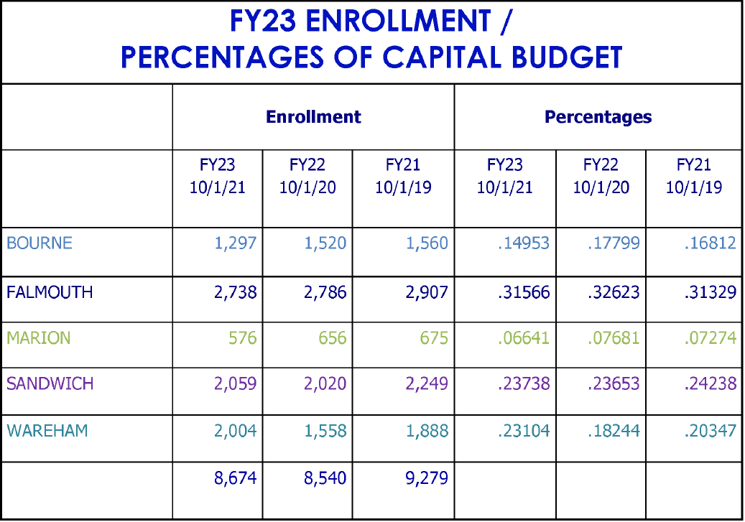
FY2023 Foundation Enrollment = 180
FY2024 Enrollment increase anticipated
Notes:
This calculation is based on enrollment and other financial factors

Slide 26
Debt Service
FY2022
Total Debt Service Expended for FY2022 - $6,8821,451 or 10% of the Total Budget
Debt service consists of exempt (63%), non-exempt (27%) and funded debt (10%)
Budgeted debt service costs decreased approximately $500K from FY2021
No permanent financing during FY22
Short-term notes will be renewed with the intent to permanently finance when school projects (including MSBA audits) are finalized – in the meantime, we will continue to pay down short-term notes as required –$270K was paid down on short term notes in FY22.
Reduction in outstanding debt/expense will help mitigate the affordability future obligations - Tax Exempt Lease and SRF loan set to be added in FY24
Financing strategy for future years utilizes off-budget revenue sources to finance capital items (Capital Stabilization Fund) – this will take some of the pressure from debt off the operating budget
Total short-term debt (all funds) @ 6/30/2022 = $10,260,674
Total long-term debt (all funds) @ 6/30/2022 = $46,493,834 ($5,014,417 or 9.7%)

Slide 27
Financial Policy
Compliance &
Other Funds

Slide 28
Financial Polices
Free Cash – to have certified Free Cash balance of at least 5% of the current Fiscal Year General Fund Operating Budget (GFOB) at the beginning and during the fiscal year; Certified Free Cash at July 1, 2022 was $9,493,497 or 12.9% of the GFOB.
Stabilization Fund – to maintain a long term Stabilization Fund for unforeseen emergency expenses and capital projects in accordance with MGL C40 §5B and to maintain a balance of at least 6% of the GFOB; no transfers were need during fiscal 2021 to meet policy. Stabilization Fund balance at July 1, 2022 was $4,433,367 or 6% of GFOB. Funds are reported at Fair Market Value and adjusted monthly.
OPEB Trust Fund - To maintain an OPEB Trust fund to accumulate funds for Other Post Employment Benefits. The long term goal for the Trust Fund is to fully fund the OPEB Liability. Beginning in fiscal 2019, OPEB expense was incorporated into the budget. This is calculated as the amount previously budgeted plus 10% of the actual new growth for the current year. The budgeted expense in FY2022 was $213,907. The town will also strive to contribute 10% of excess free cash over policy to the fund at fall town meetings. In addition to the $213,907 budgeted, $805,000 was transferred to the trust in fiscal 2022. Total trust balance at year end was $5,805,961. The net OPEB liability as of 6/30/2022 was $63,733,984. The liability is 8.91% funded. Based on our current funding schedule and contributions, the liability has reached it’s “tipping point.” The liability has decreased more than 50% from the prior year valuation.

Slide 30
Free Cash to Financial Policy

Slide 33
Receipts Reserved for Appropriation
Proceeds that are earmarked by law and placed in separate accounts for appropriation for particular purposes. For example, parking meter proceeds may be appropriated to offset certain expenses for parking meters and the regulation of parking and other traffic activities
Source: MA DOR DLS, Municipal Finance Glossary, May 2008
Notes:
Another Goal Achieved from the Strategic plan – Section 4.2.7 – - Recovered additional federal revenue from the Certified Public Expenditure* (CPE) program; approximately $100K - LTP to set these funds aside for future ambulance costs;
Balance closed approx. $210K hire in FY21 – due to CPE & increase in rates

Slide 34
FY22 Grant Funding Received
(Outside General Fund Budget)
Bourne Received more than
$7,000,000
in grant funding during fiscal year 2022
Chapter 90, State Aid to Highways = $2,506,828
COMIRS Radio Upgrade = $214,893
CARES Act Coronavirus Relief Fund = $214,893
State 911 Support & Training = $125,442
Dredging Grant = $110,566
FEMA (COVID) = $104,696
Bourne Rail Trail P1&2 = $100,000
School Circuit Breaker = $473,111
Special Education Cluster (94-142) = $722,093
Title I = $224,906
PL874 Grant (Federal Military Aid) = $128,391
Foundation Reserve (State Military Aid) = $782,175
CARES ESSER II = $769,099
CARES ESSER III = $360,231
F.A.S.T = $129,843
Accelerating Literacy Learning = $100,950

Slide 35
American Rescue Plan Act
(ARPA)
Total Direct Funds Awarded = $2,068,460
Funds have been allocated for various sewer projects and technology upgrades in FY23/24
Funds must be committed no later than 12/31/2024 and expended no later than 12/31/2026
County ARPA awarded in FY23 for the purchase of two ambulances ($750,276) and school technology plan ($107,115)
Additional County ARPA funds may be available

Slide 36
Enterprise Funds
An enterprise fund, authorized by MGL Ch. 44§53F ½, is a separate accounting and financial reporting mechanism for municipal services for which a fee is charged in exchange for goods or services.
Bourne operates two enterprise funds:
Trash Disposal - Integrated Solid Waste Management Department
Sewer - Sewer Department
***Both funds are self supporting and do not require subsidies from the General Fund***

Slide 37
Enterprise Funds
ISWM & Sewer
ISWM retained earnings decreased from $10,800,612 to $10,219,777 at year end – a decrease of $580,836 or 5.4%. Total fund equities at year end increased from $23,616,715 to $26,640,337; this includes $16,420,560 reserved for various purposes (ie capital articles, post closure, etc)
Sewer retained earnings decreased from $ 859,035 to $856,818 at year end – an decrease of $2,216 or 0.26%

Slide 42
Conclusion
Overall, the Town’s financial position is favorable and sustainable based on current services provided. The town is compliant with Financial Policies and Industry Standards – DOR certifications are current, Financial Statement Audits have resulted in unqualified opinions and our bond rating remains stable.
We have made various changes in our financing strategies to maintain this healthy position –
  Reduce reliance on free cash to balance the budget
  Limit borrowing needs and transition to a pay-as-you-go capital plan
  Increase reserves (general, capital, and climate stabilization)
  Increase OPEB Contributions
The Finance Team will continue to explore and implement strategies to strengthen our positions, including bond rating upgrade and financial policy review

Slide 43
Any Questions?

