Slide 1
Project Overview: SNEP Network & Town of Bourne, MA
7a.

Slide 2
Project Summary
Apr. 2020: Bourne submits CFP
Jun. 2020: MOA finalized
Aug-Nov. 2020: Bi-weekly workgroup meetings
Jul. 2020: Project Kickoff
Dec. 2020: First drafts with Bourne's feedback
Jan. 2021: Finalize deliverables
Feb. 2021: Deliverables due and project concludes
Technical services SNEP will provide to Bourne:
A Coastal Resilience Action Strategy (key recommendations, prioritized climate resilience projects, actions, and implementation criteria to determine greatest need, impact, and opportunity)
Sustainable and scalable financing options (to lead Bourne towards successful long-term implementation)
Resilience Capacity Review: Provides details and gauges community capacity
Criteria for Funding: Categorizes projects based on funding needs (short-, mid-, or long-term)
Town Reports/Plans Q&A: In-depth review and questions about town planning documents (Downtown Action Plan, MVP, Open Space & Recreation Plan, Local Comprehensive Plan)
Coastal Resilience Financing Assessment
Part 1: Defining Resilience, Assessing Risk, and Planning for the Future
Part 2: Creating a Resilient Financing System
Recommended next steps
Climate Project Prioritization Toolkit: Resource to help prioritize projects and plan action using relative measures of hazards, vulnerabilities, and risk.

Slide 3
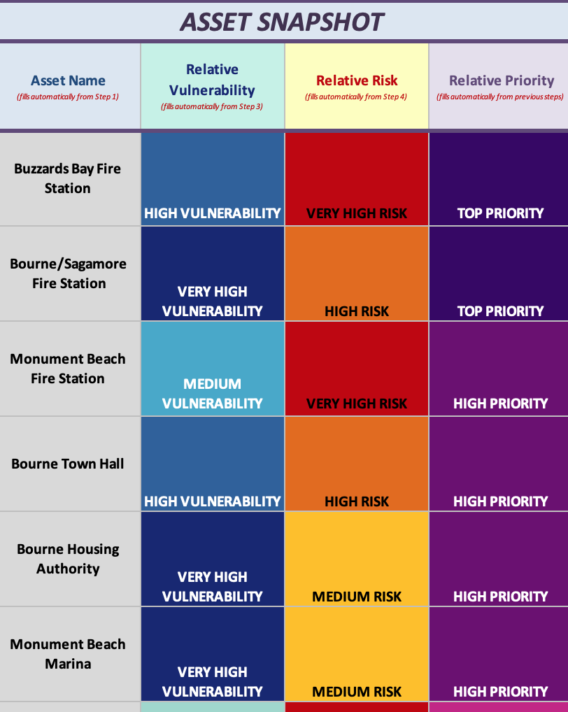
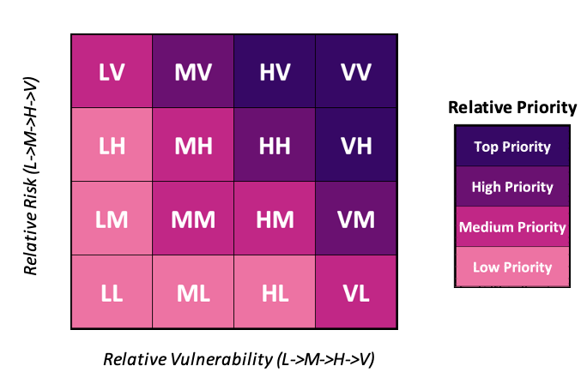
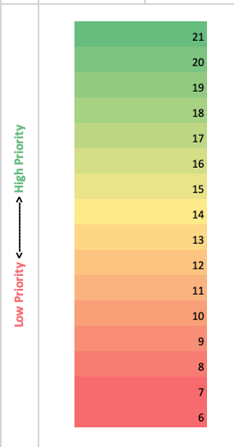
Step 5

Slide 4
Key Findings
There’s been encouraging progress on resilience so far. A clear community-based vision would provide framework for future investments.
There’s a growing understanding of hazards and assets. A standardized process to prioritize action and improve preparedness would create efficiency and improve resilience.
Climate threats will require expanding funding, investment, and institutional capacity (short-term and long-term).
Enhancing resilience and improving infrastructure has direct linkages to economic development.
Bourne has a strong economy, very strong financial management, and dedicated leadership. Bourne is well-positioned for the resilience financing process.

Slide 5
Recommendations
Part 1: Defining Resilience, Assessing Risk, and Planning for the Future
Part 2: Creating a Resilient Financing System
Build on MVP to create a community outreach plan that develops understanding of the changes that are needed for resilience vision
Develop COOP Plans for all departments in the Town
Ensure community planning addresses resilience on all fronts (economic, environmental, social)
Plan for and create a dedicated financing institution or enterprise program
Directly connect resilience planning to infrastructure and economic development priorities
Identify appropriate corporate structure
Identify the most sufficient, stable, and equitable revenue streams
Codify procurement policies (selection of competition, contract type, and payment structure, etc.)

Slide 6
Conclusion & Discussion
Recommended next step: Establish an enterprise program to better position Bourne for the future (no fiscal commitment yet)
Bourne can be a leader on climate resilience planning and financing on Cape Cod and across Massachusetts.
By prioritizing investments and dedicating revenue through a resilience financing system, the SNEP Network envisions Bourne attracting private and philanthropic capital, maintaining its bond rating, and leveraging additional state/federal funding.
Questions and feedback?

