Slide 1
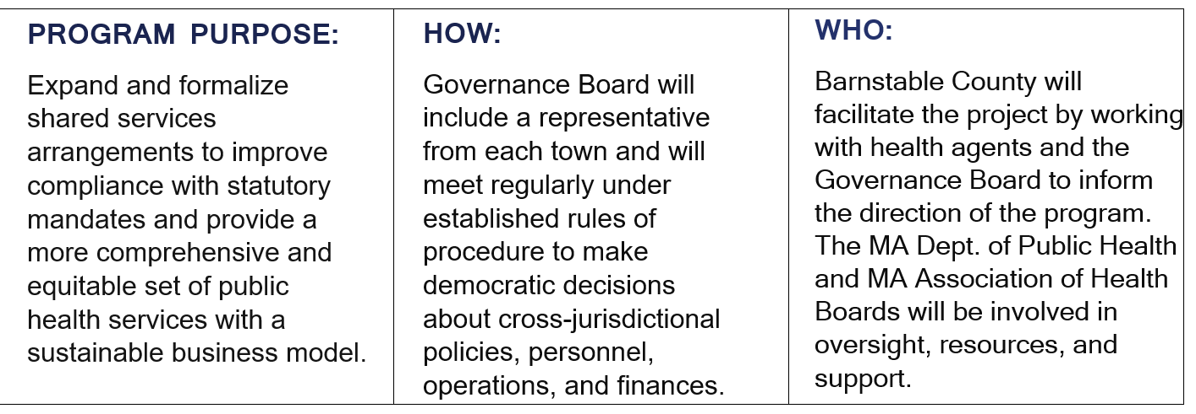
Barnstable County Public Health Excellence (PHE) Grant for Cross-Jurisdictional Sharing

Slide 2
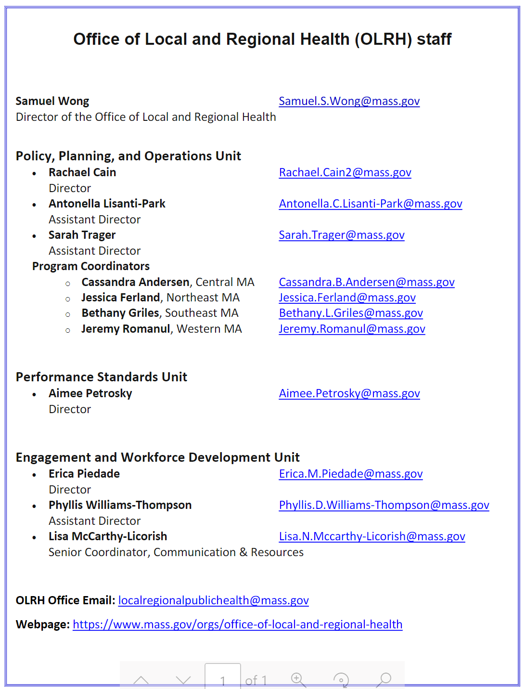

Slide 5
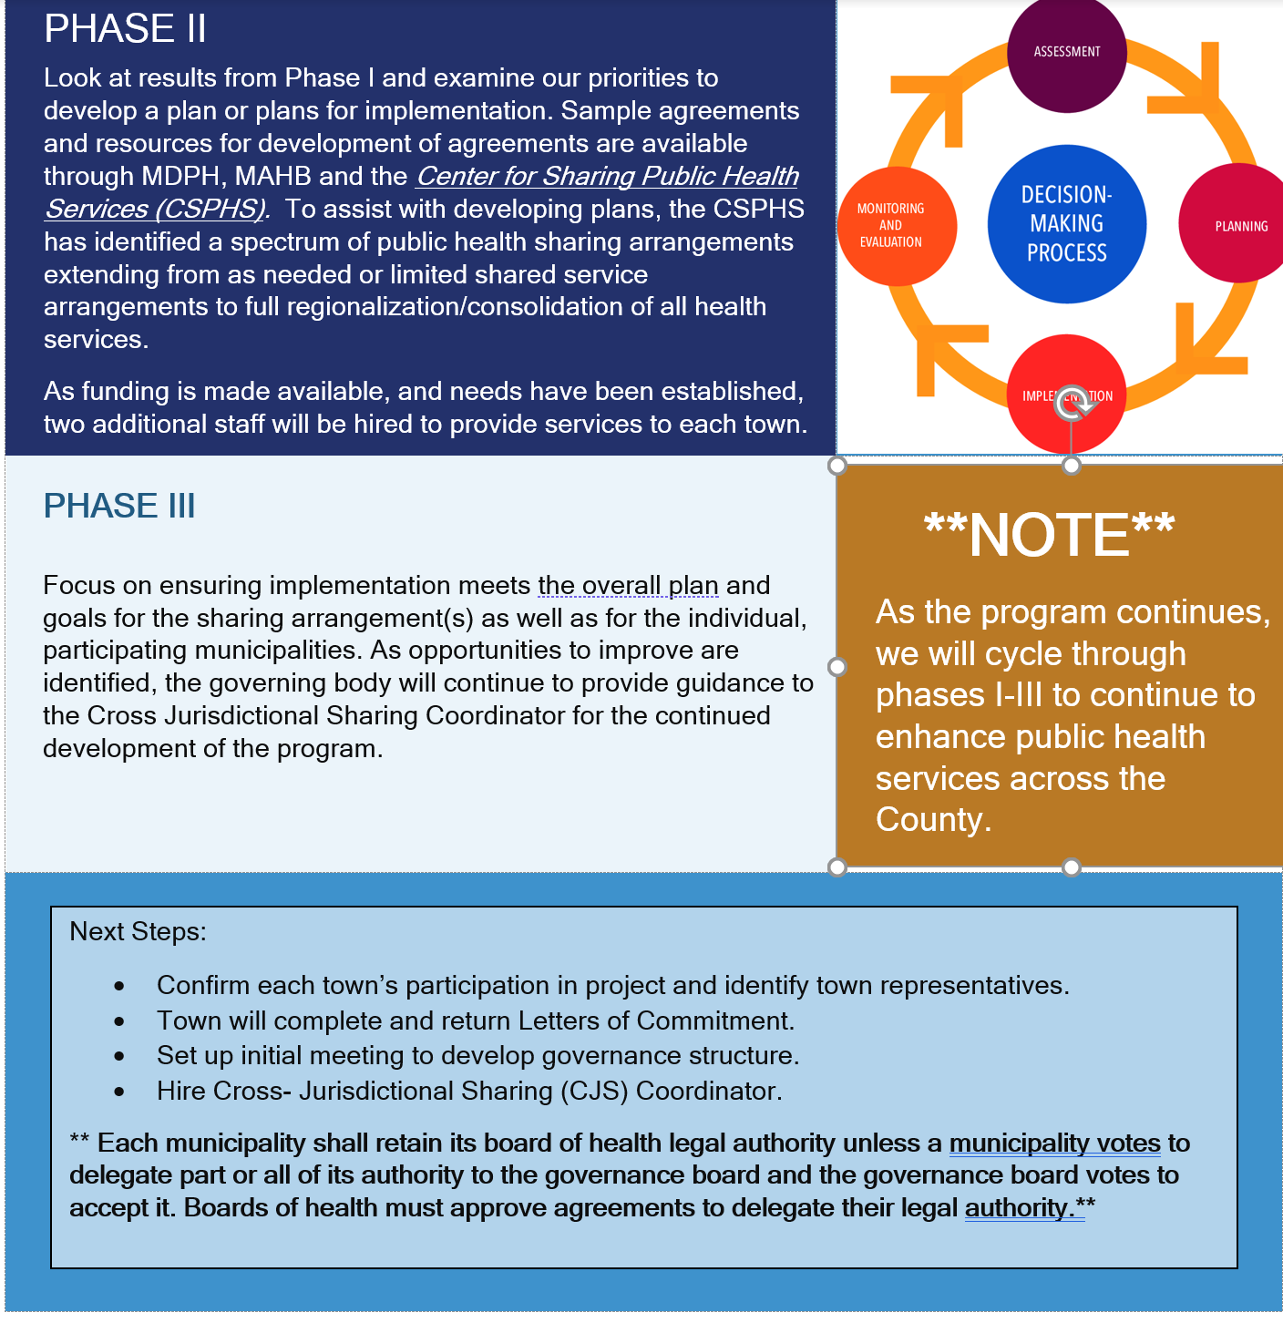
We will have flexibility to build this program to suit each towns’ needs
Hybrid approach which MAY include the following:
Smaller regional arrangements between a few towns for staff sharing, inspectional services, local programs etc.
Larger regional programs that can address issues that are common to most or all towns.
NOTE: Current funding is $300,000 annually.
(Barely enough for 3 staff)
Capacity assessment to be distributed by MDPH soon, results may result in increased funding going forward. There will be no more increases after this point. In my opinion, the more towns we have in our group, the greater the probability that we will

Slide 6
Quarterly governance meetings to be attended by health agent or designee.
Commitment to data collection through MAVEN, MIIS and other software to be developed. (food, housing, camps, licensing etc.)
Commitment to workforce standards for staff as defined by the Special Commission on Local and Regional Public Health. Registration and travel costs will be reduced by local training hub to be developed as part of this program.
Town commitment
Quarterly governance meetings:
Attended by HD or designee
Goal is to keep these concise
If all agree, will have on same day as regular HAC meetings, likely at 12:30 so everyone can also attend the MDPH calls
Important to get input from all towns
Important to have a forum for discussion in addition to regular HAC update
Commitment to data collection:
MAVEN
MIIS
Other software to be developed

Slide 7
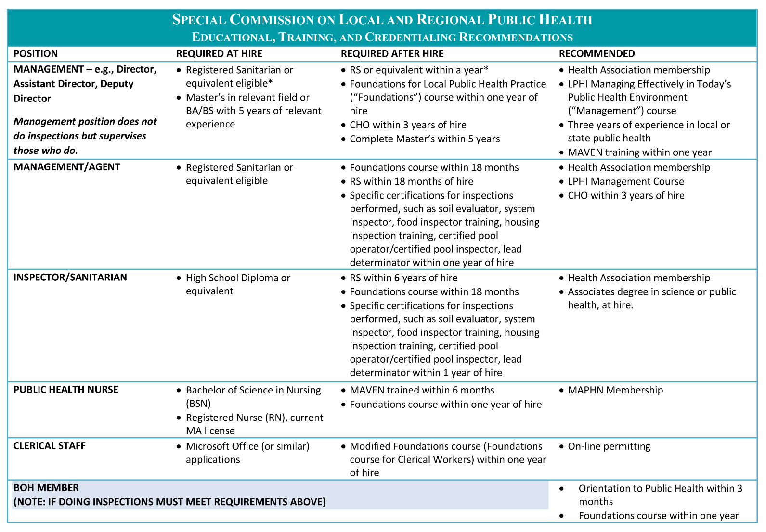

Slide 8
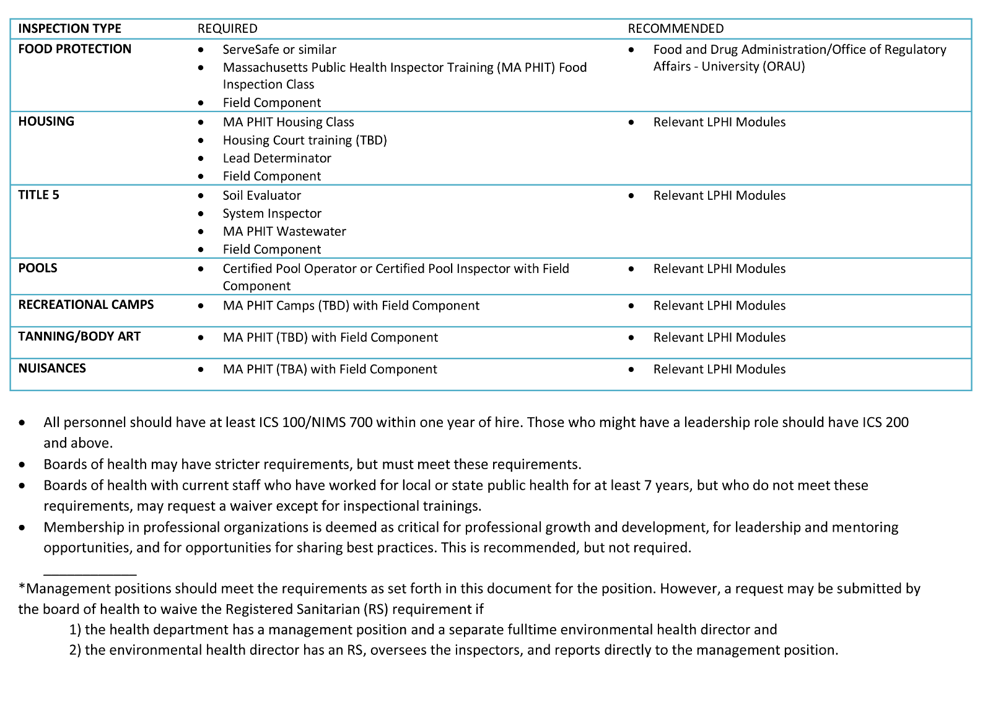

Slide 9
We are planning to be one of these training hubs

Slide 11
Town Investment
Quarterly governance meetings to be attended by health agent or designee.
Commitment to data collection through MAVEN, MIIS and other software to be developed. (food, housing, camps, licensing etc.)
Commitment to workforce standards for staff as defined by the Special Commission on Local and Regional Public Health. Registration and travel costs will be reduced by local training hub to be developed as part of this program.
Enhanced support for current coordinated efforts such as cyanobacteria, PFAS and hoarding.
Development of new programs such as community health outreach, enhanced disease surveillance and mitigation, and mental health assessment and services. (and many more)
Workforce Development through a local public health training hub.
Support for smaller, voluntary, shared services collaborations as identified by individual towns.
Improved health equity across the region.
Enhanced capacity, improved efficiencies and cost savings.
**NOTE: Each municipality shall retain its board of health legal authority unless a municipality votes to delegate part or all of its authority to the governance board.**
This means that a commitment to the program is not a commitment to each individual project within the program. For example, A program that is developed for shared inspectional services will ONLY include those towns that are interested in participating.
Program Benefits

