Slide 1
Impact of stormwater runoff from Wildwood Lane to 7 Alpine Circle

Slide 2
FOUR CATASTROPHIC FLOODS SINCE SEPTEMBER 2021
September 2, 2021
August 2, 2022
August 3, 2022
September 10, 2023

Slide 3
September 2, 2021

Slide 4
August 2, 2022

Slide 5
August 3, 2022

Slide 6
The most recent flood on September 10, 2023. There was over 21 inches of water in our driveway, flooding the new accessory dwelling and basement.

Slide 7
Extensive Drainage Improvements at 7 Alpine Circle
Previous owner- Installed a catch basin in the center of the driveway in addition to catch basin at the end of the driveway at street level.
WE have made the following improvements since 2021:
Installed drain in front of garage in the spring of 2022
Approved for accessory dwelling in the fall of 2022 which removes garage to eliminate water flow under garage doors
Modified the foundation of accessory dwelling to prevent flooding (reverse brick shelf)
Installed additional catch basin next to catch basin installed by previous owner and added a larger opening to catch water
Installation of new driveway pitched to steer water away from the house
Changed the grade of side and back yard to divert water flow away from the house

Slide 8
Drainage System Results
After spending thousands of dollars for extensive drainage improvements at 7 Alpine Circle, the improvements made were not capable of handling the stormwater runoff coming from the subdivision of Ocean Pines Condominiums.

Slide 9
Evidence of water flow coming from Ocean Pines Condominiums on Wildwood Lane

Slide 10
Significant storms producing stormwater runoff causing water and sediment coming from Wildwood Lane to cross Ocean Pines drive.

Slide 11
Water continues to flow across Ocean Pines Drive through the driveway and yard of 15 Ocean Pines Drive as seen here.

Slide 12
Video of water gushing from Wildwood Lane down the driveway of 15 Ocean Pines Drive

Slide 13
View from Ocean Pines Drive of the sediment washout from Wildwood Lane to 15 Ocean Pines Drive.

Slide 14
View from the bottom of the driveway of 15 Ocean Pines Driveway of the sediment wash out coming from Wildwood Lane.

Slide 15
Picture provided by our neighbor at 6 Alpine Circle of the water flowing through fence behind 15 Ocean Pines into 6 Alpine Circle

Slide 16
Impact of stormwater runoff on 4 Alpine Circle from Ocean Pines Condominiums
Statement from resident at 4 Alpine Circle:
Flooded shed and sediment from Ocean Pines Condominiums
“Since development of the condos on Wildwood Lane, I have experienced flooding around my shed and in my side yard. Whenever there is a hard rainfall the water from Wildwood Lane pours down the driveway of my neighbors house on 15 Ocean Pines Drive, which is directly across from Wildwood Lane, and into my side yard at 4 Alpine Circle. The water floods the area around my shed and side lawn. I need to wait until the water recedes to access my shed. I am worried about the damage to both my shed and fence from the continual water flow and flooding. The water then continues to make its way from my yard to my neighbors home at 7 Alpine Circle and has caused extensive damaging floods numerous times. Corrective measures should be taken by the condo developer to address the drainage issues that are impacting the residents of Ocean Pines Drive and Alpine Circle.”

Slide 17
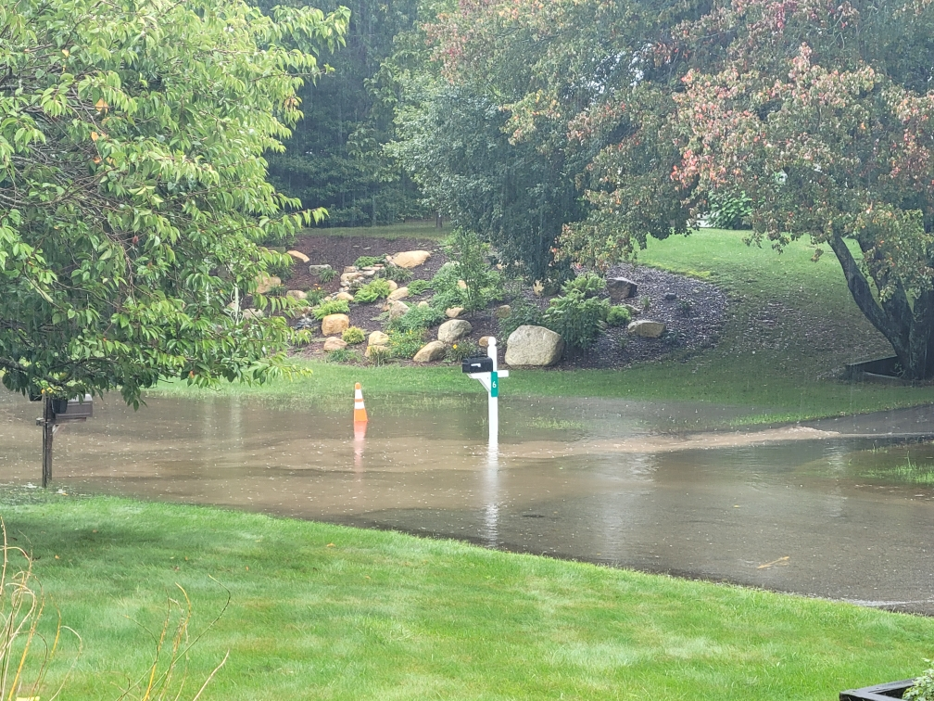
Picture provided by neighbor at 5 Alpine Circle of water and sediment flowing from Wildwood through 4 and 6 Alpine Circle to 7 Alpine Circle

Slide 18
Picture provided by neighbor at 9 Alpine Circle of flooding between 9 and 7 Alpine Circle during most recent flood on September 10th.

Slide 19
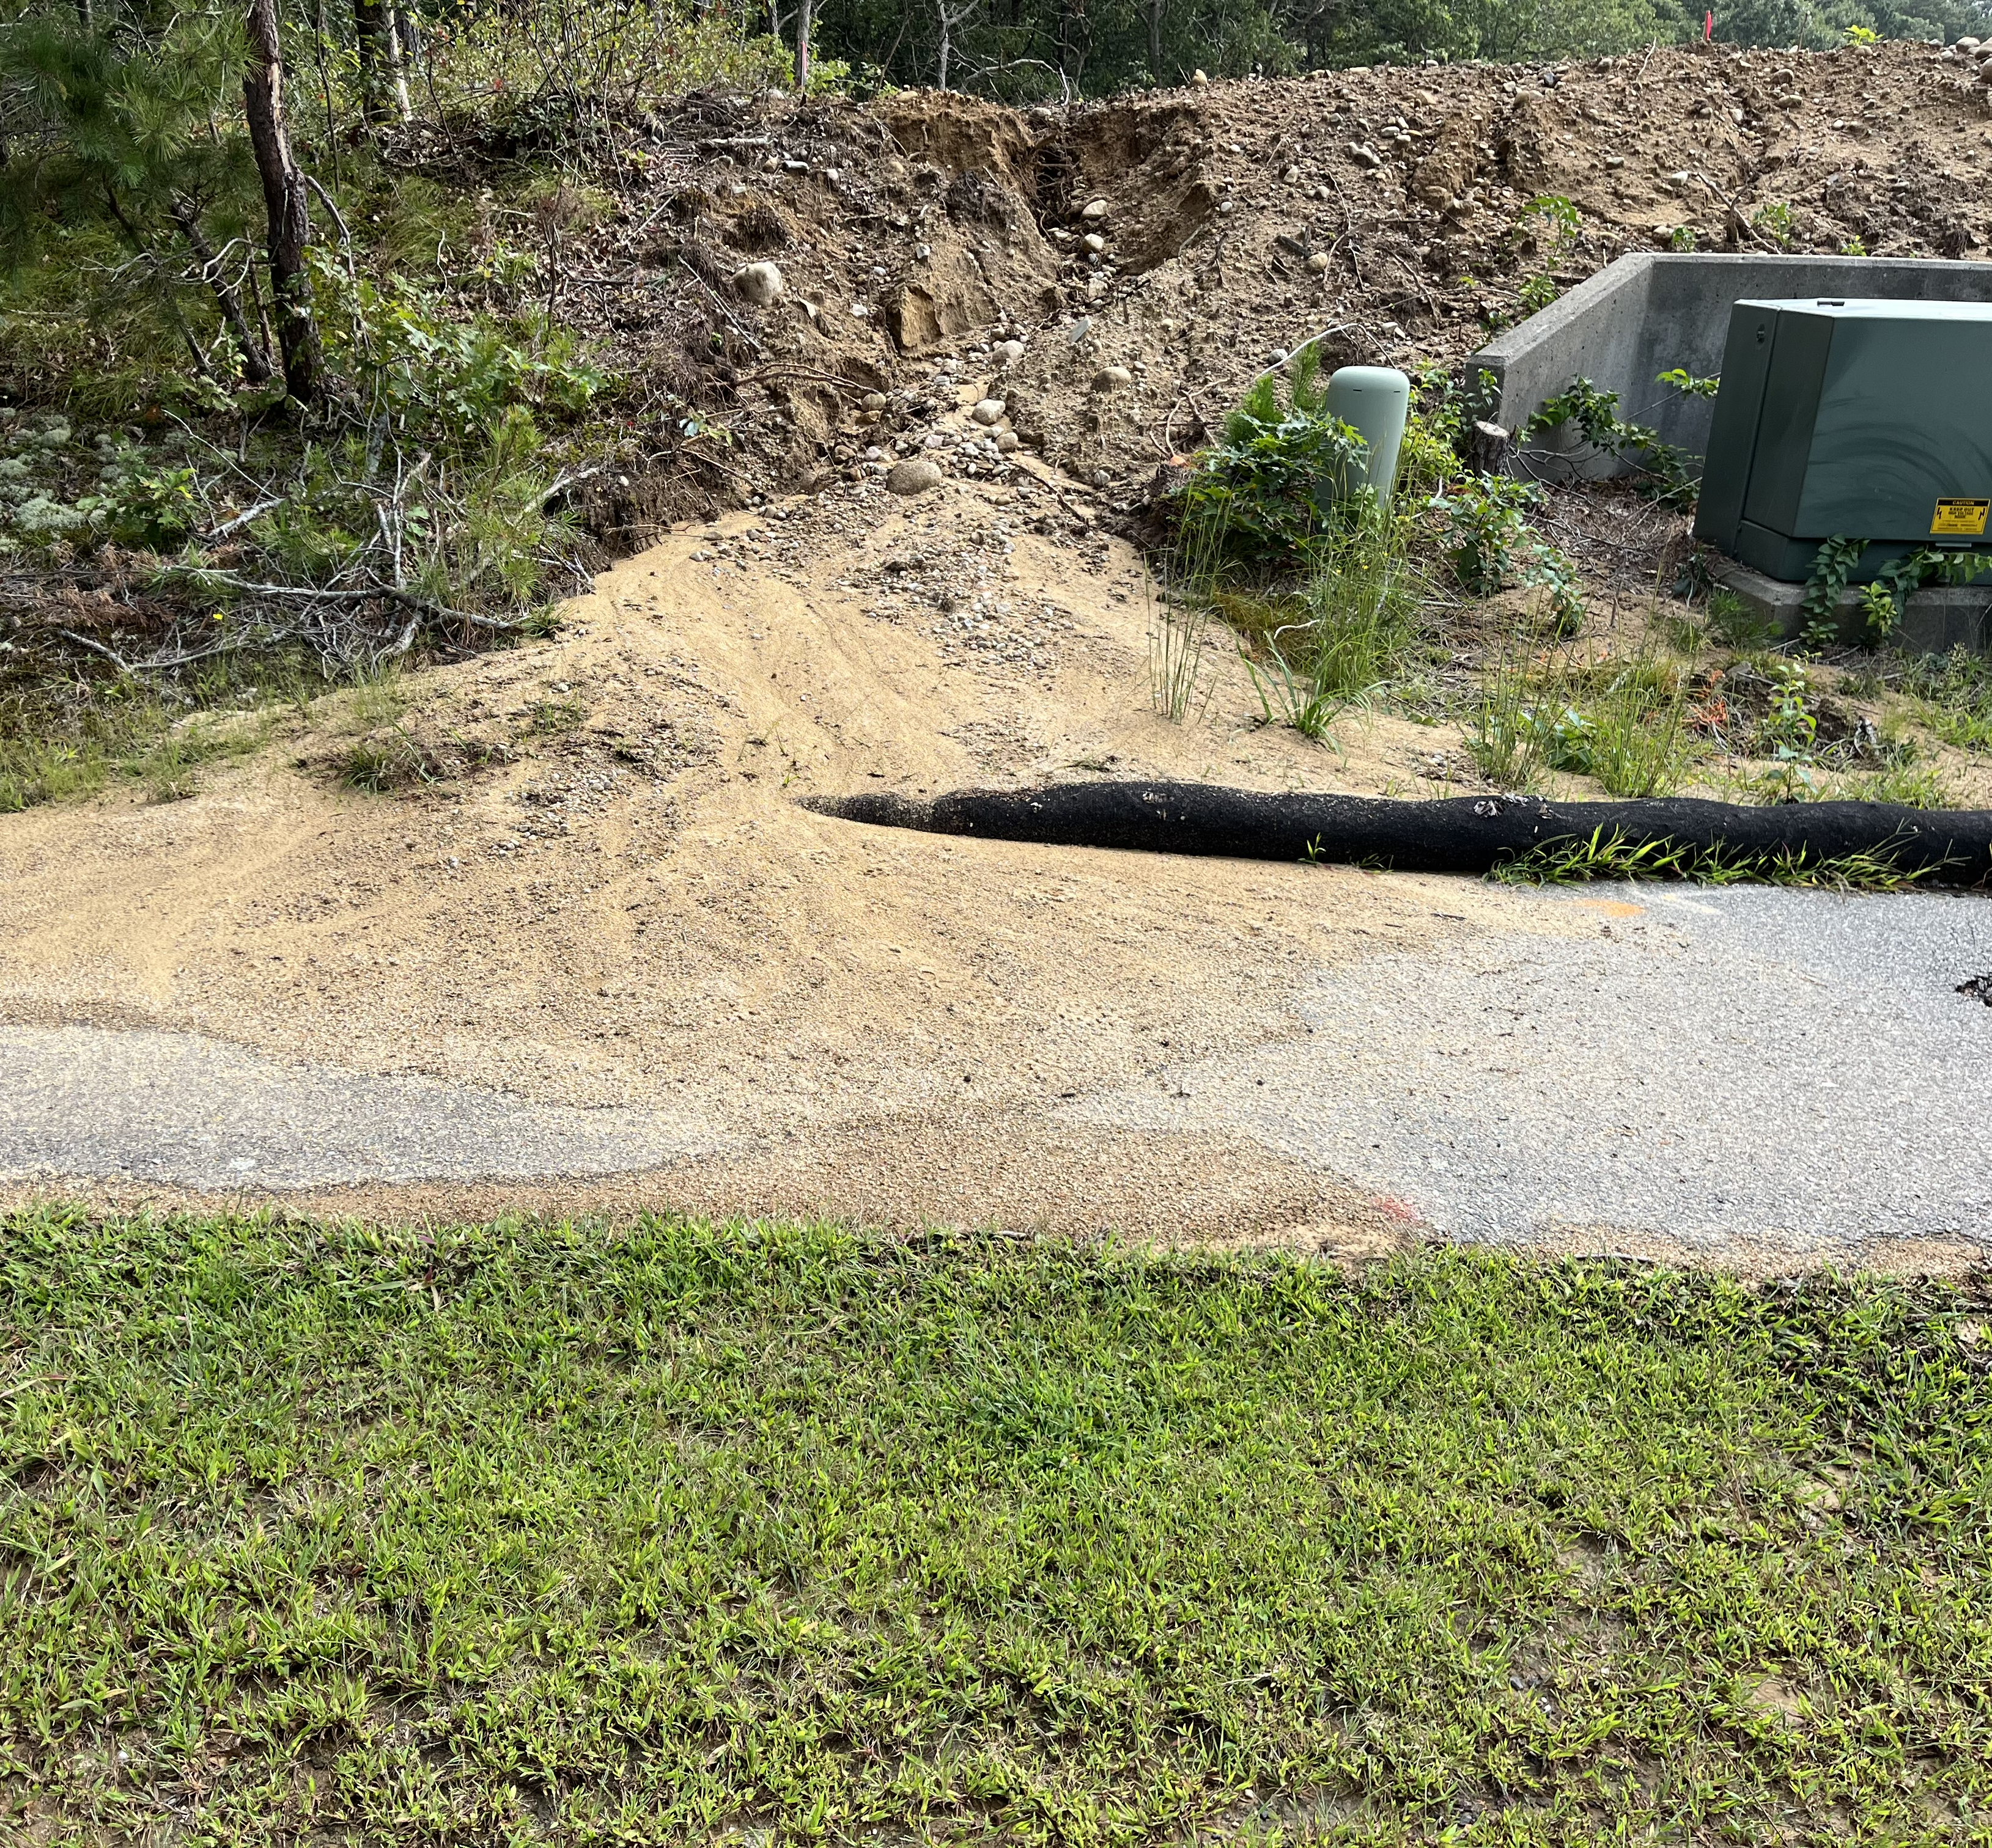
Picture taken shortly after the flooding occurred on September 10, 2023 showing the wash out from the construction site of Ocean Pines Condominiums into the sidewalk and on Ocean Pines Drive.

Slide 20
Complaints filed with the Town of Bourne
Original complaint filed September 2021 by phone to the building inspection office with concerns of water coming from Ocean Pines.
Response by Town Engineer the developers of Ocean Pines were fulfilling their requirements.
Second complaint filed August 2022 via phone calls to Building Inspector and Town Engineer.
Determination that Ocean Pines Condominiums had burlap bags blocking the drains, the basins were above grade and filled with sediment resulting in the basins not taking in any water.
Follow up emails to Building Inspector on July 10 & 18, 2023 expressing concerns about the upcoming rainy season requesting reassurance that the developers at Ocean Pines Condominiums were fulfilling their requirements with modifications to their drainage system.
Third complaint filed September 11, 2023 after most recent flood and requested action be taken against the Ocean Pines Condominium Developers.

Slide 21
Confrontations from the Developer of Ocean Pines
August 2022 - Confrontations at 7 Alpine Circle by both Brian and Scott Hebb on separate occasions denying all responsibilities of stormwater runoff from Ocean Pines Condominiums.
September 10, 2023 – Scott Hebb drove to 7 Alpine Circle to witness the flood and denied all responsibility.

Slide 22
Recommendations for Hebb Construction to control stormwater runoff
Increase the size of the detention pond or add a second detention pond.
Install drain tiles across the road to catch the storm water runoff and divert to detention ponds.
Construct soft berms on Wildwood Lane to divert the water to the catch basins and detention ponds.
Change the pitch of the remaining parking lots away from Ocean Pines Drive so water will remain in their subdivision.
Or all of the above.

Slide 23
Time is of the Essence
Drainage improvements need to be finalized before the continuation of the final phase of the development.
Concerns:
Hebb Construction finishes the project and pulls out without any accountability.
Hebb Construction files bankruptcy before drainage improvements are complete.

Slide 24
Questions/Comments
Thank you for the opportunity to present our concerns.
Tom & Kristin LeClair
Residents of Alpine Circle & Ocean Pines Drive

